Slide 1
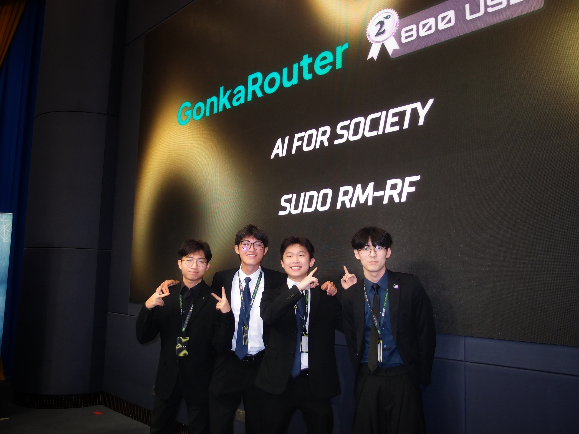
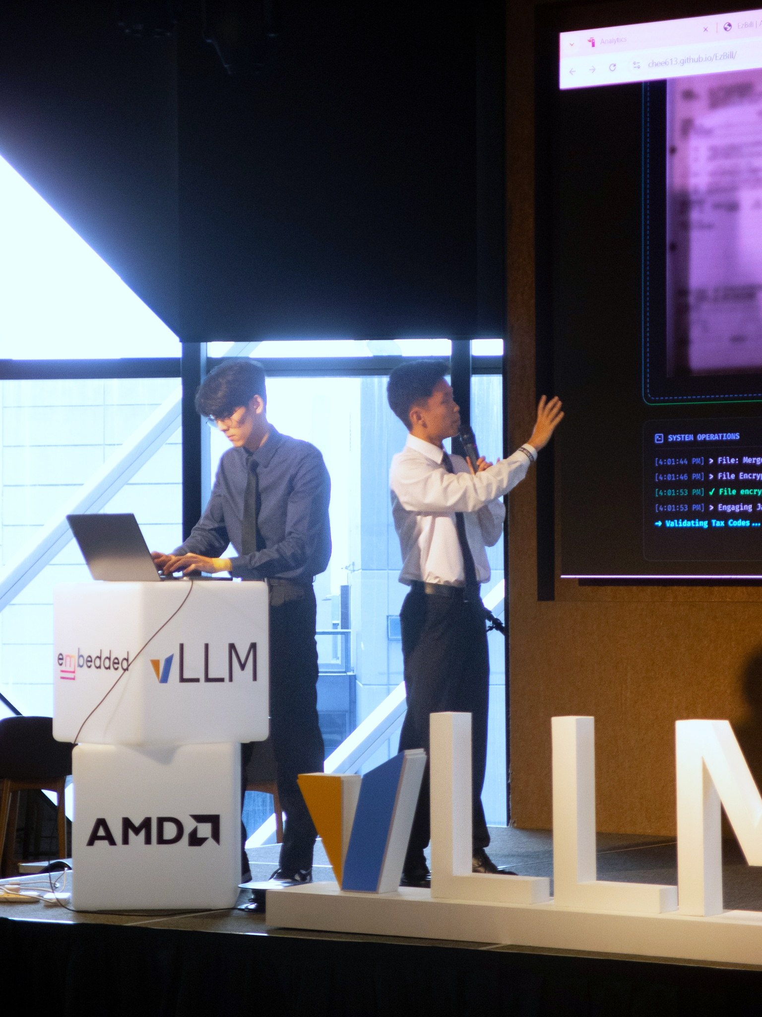
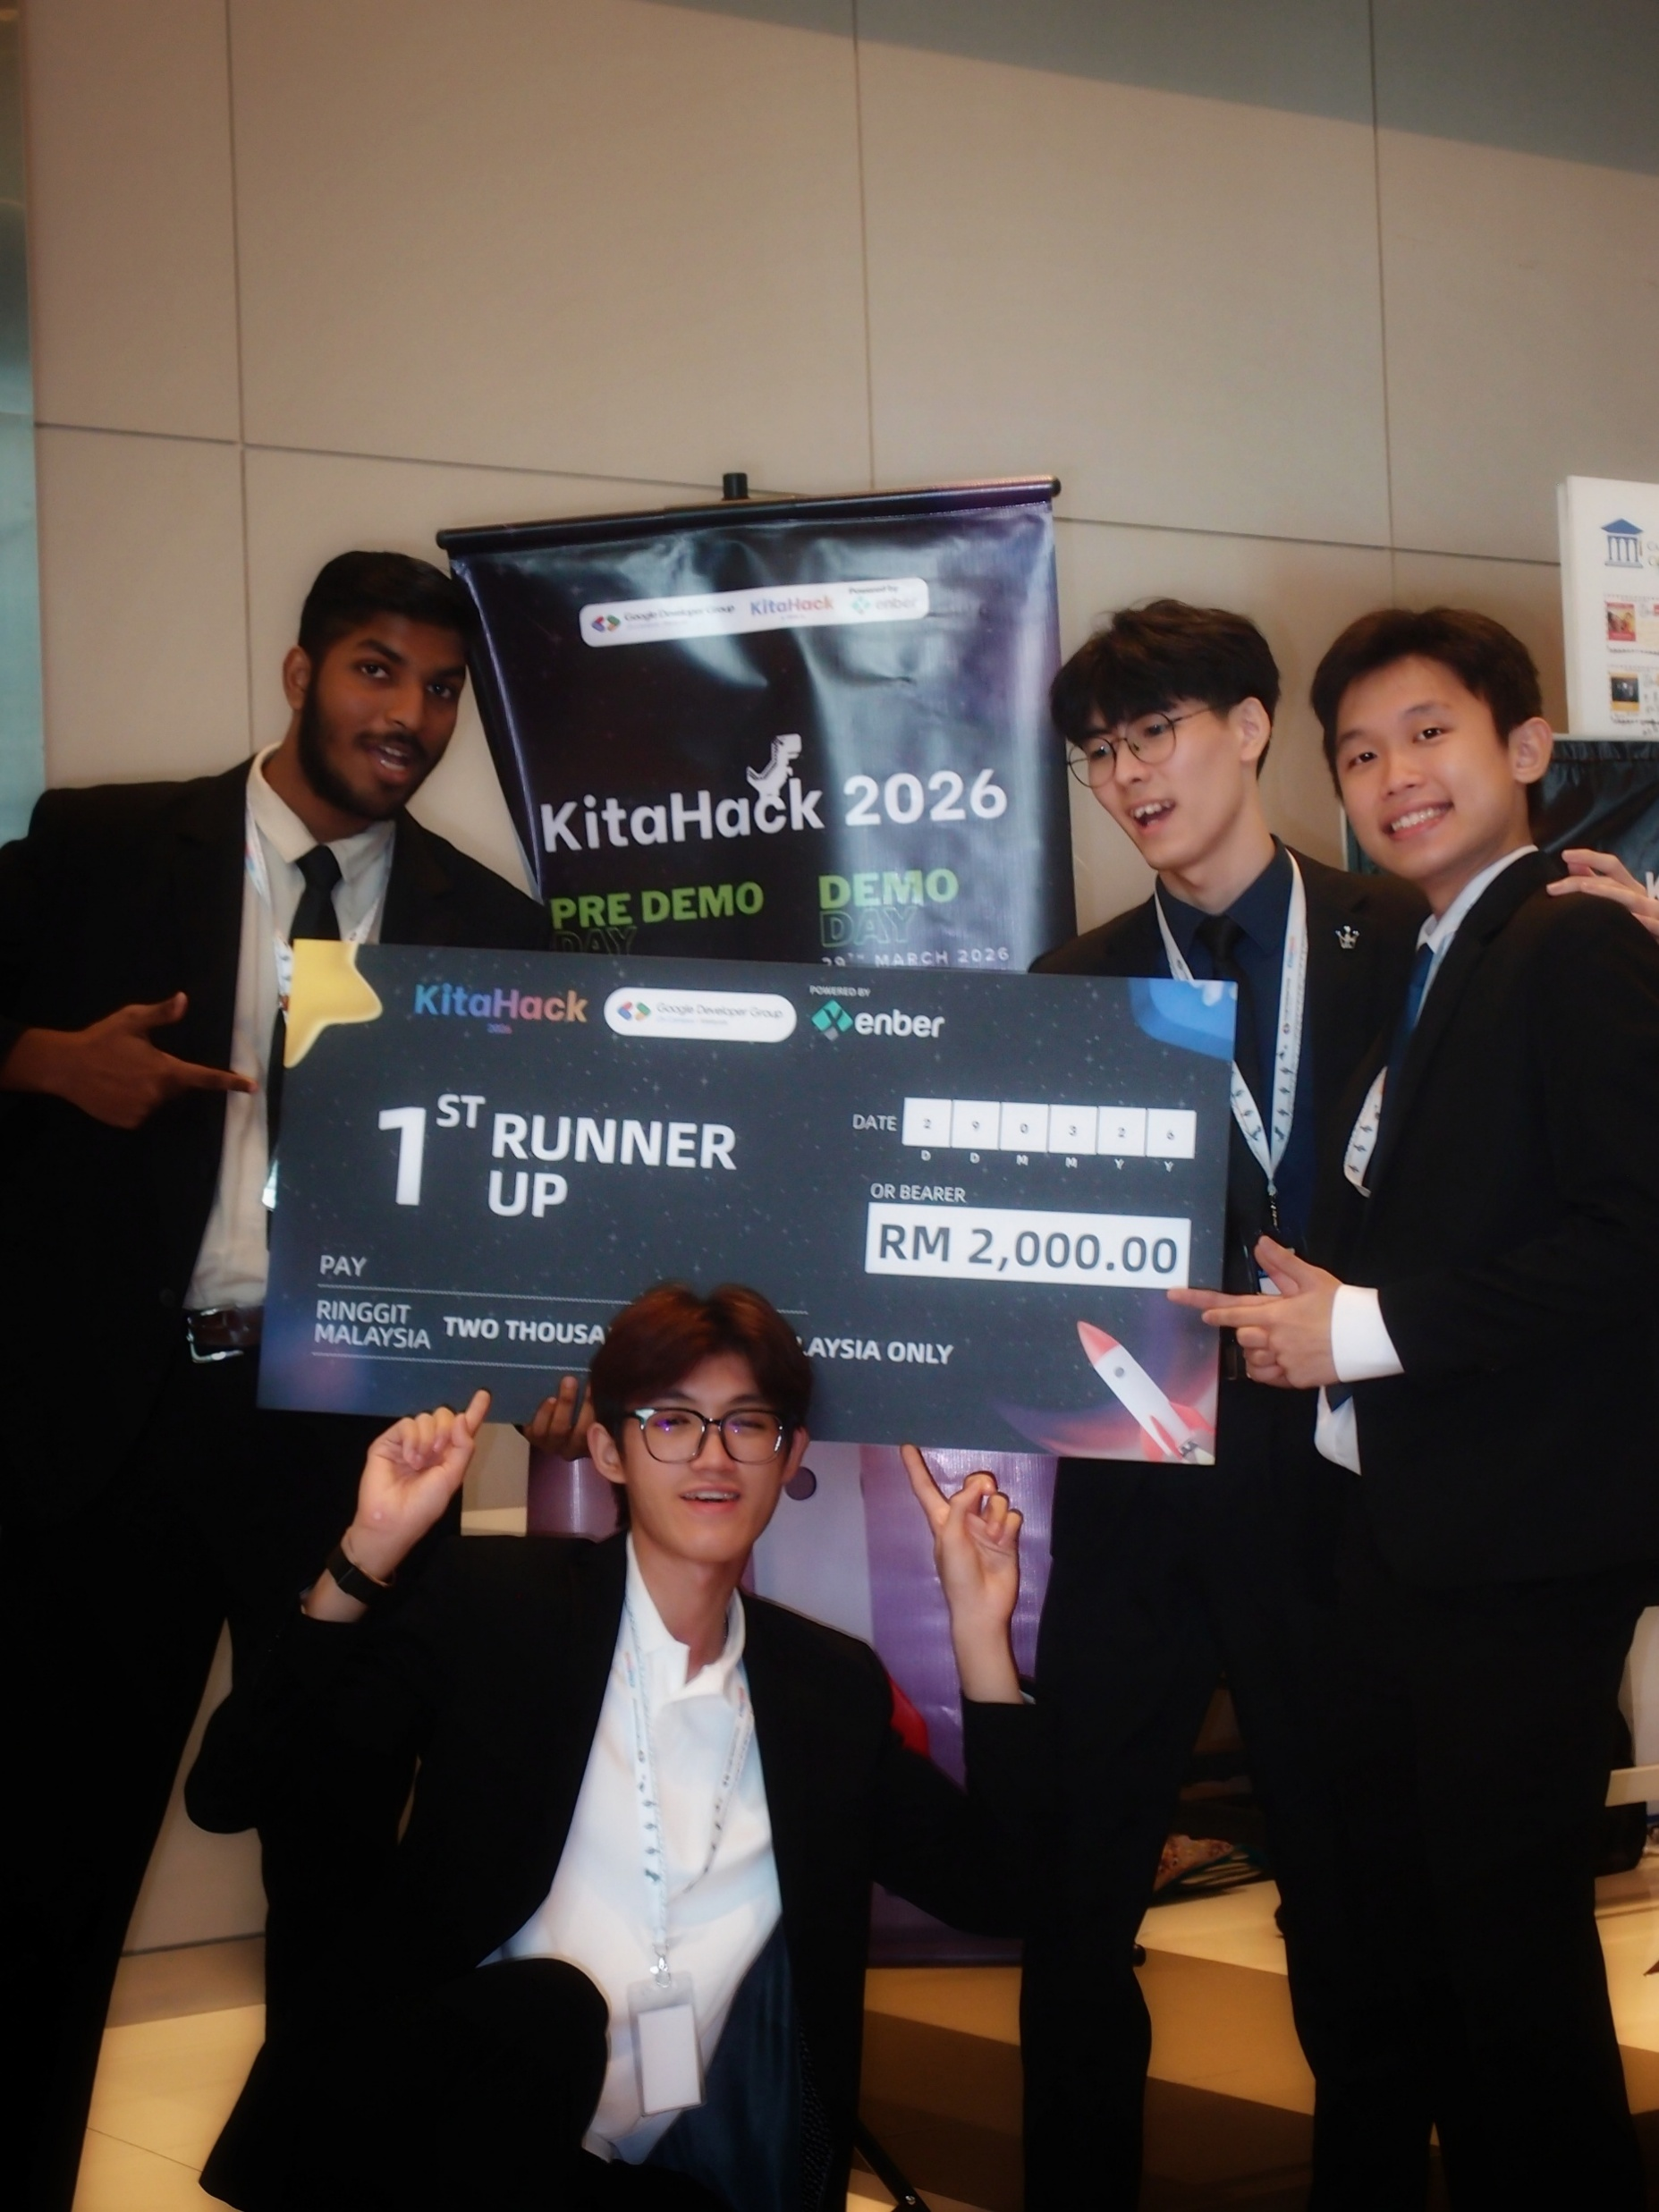
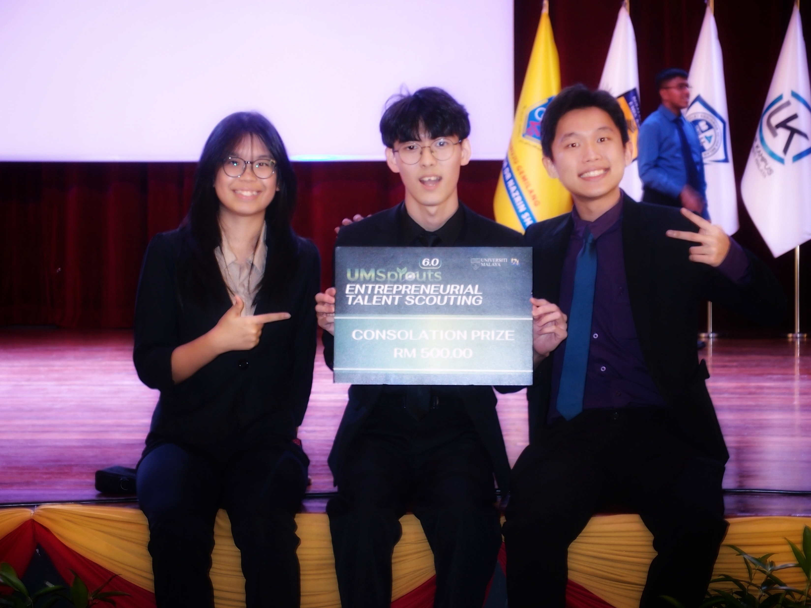
HACKATHON
02
01 / HACKATHON
9× WINNER
JOINED 11 HACKATHONS
Notes:
[Sources]
User-provided briefing.

Slide 2
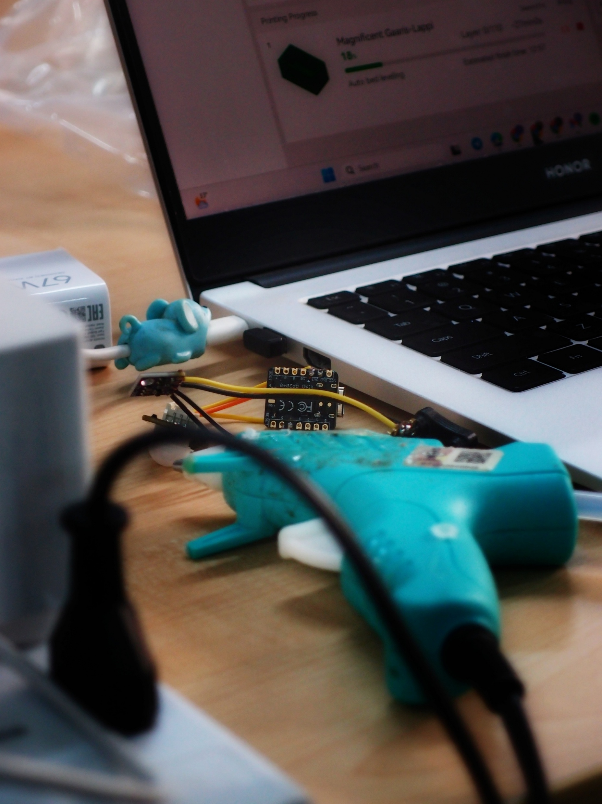
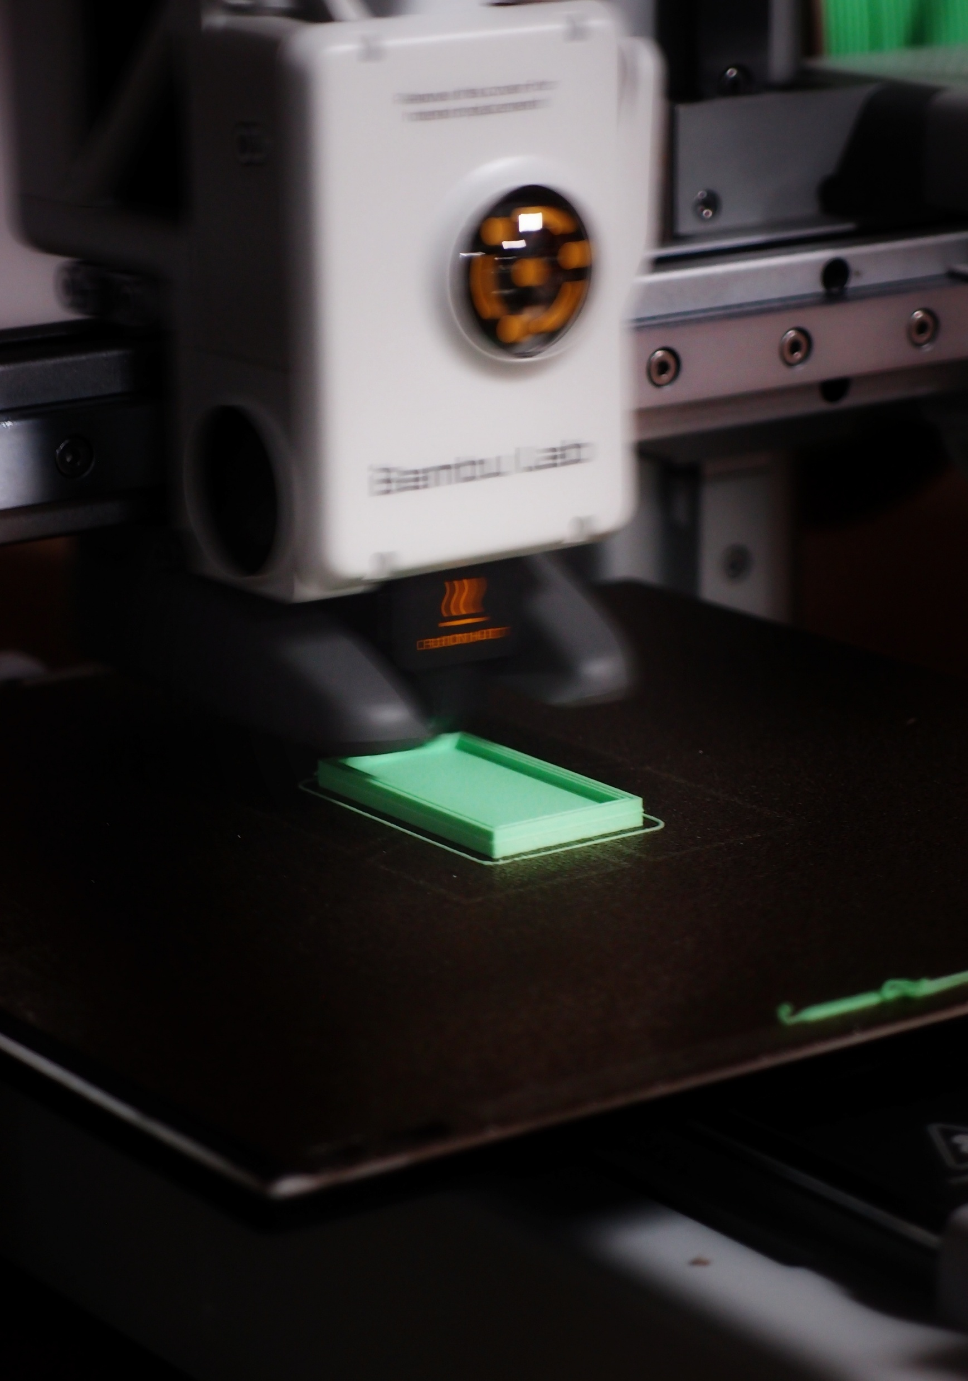
HACKATHON
04
RULES OF THUMB
SIMPLE WINS.
SIMPLE APP > CLUTTERED DASHBOARD
NEVER BUILD A CHATBOT
MACHINE LEARNING
AI + IoT = AIOT
Notes:
[Sources]
User-provided briefing.

Slide 3
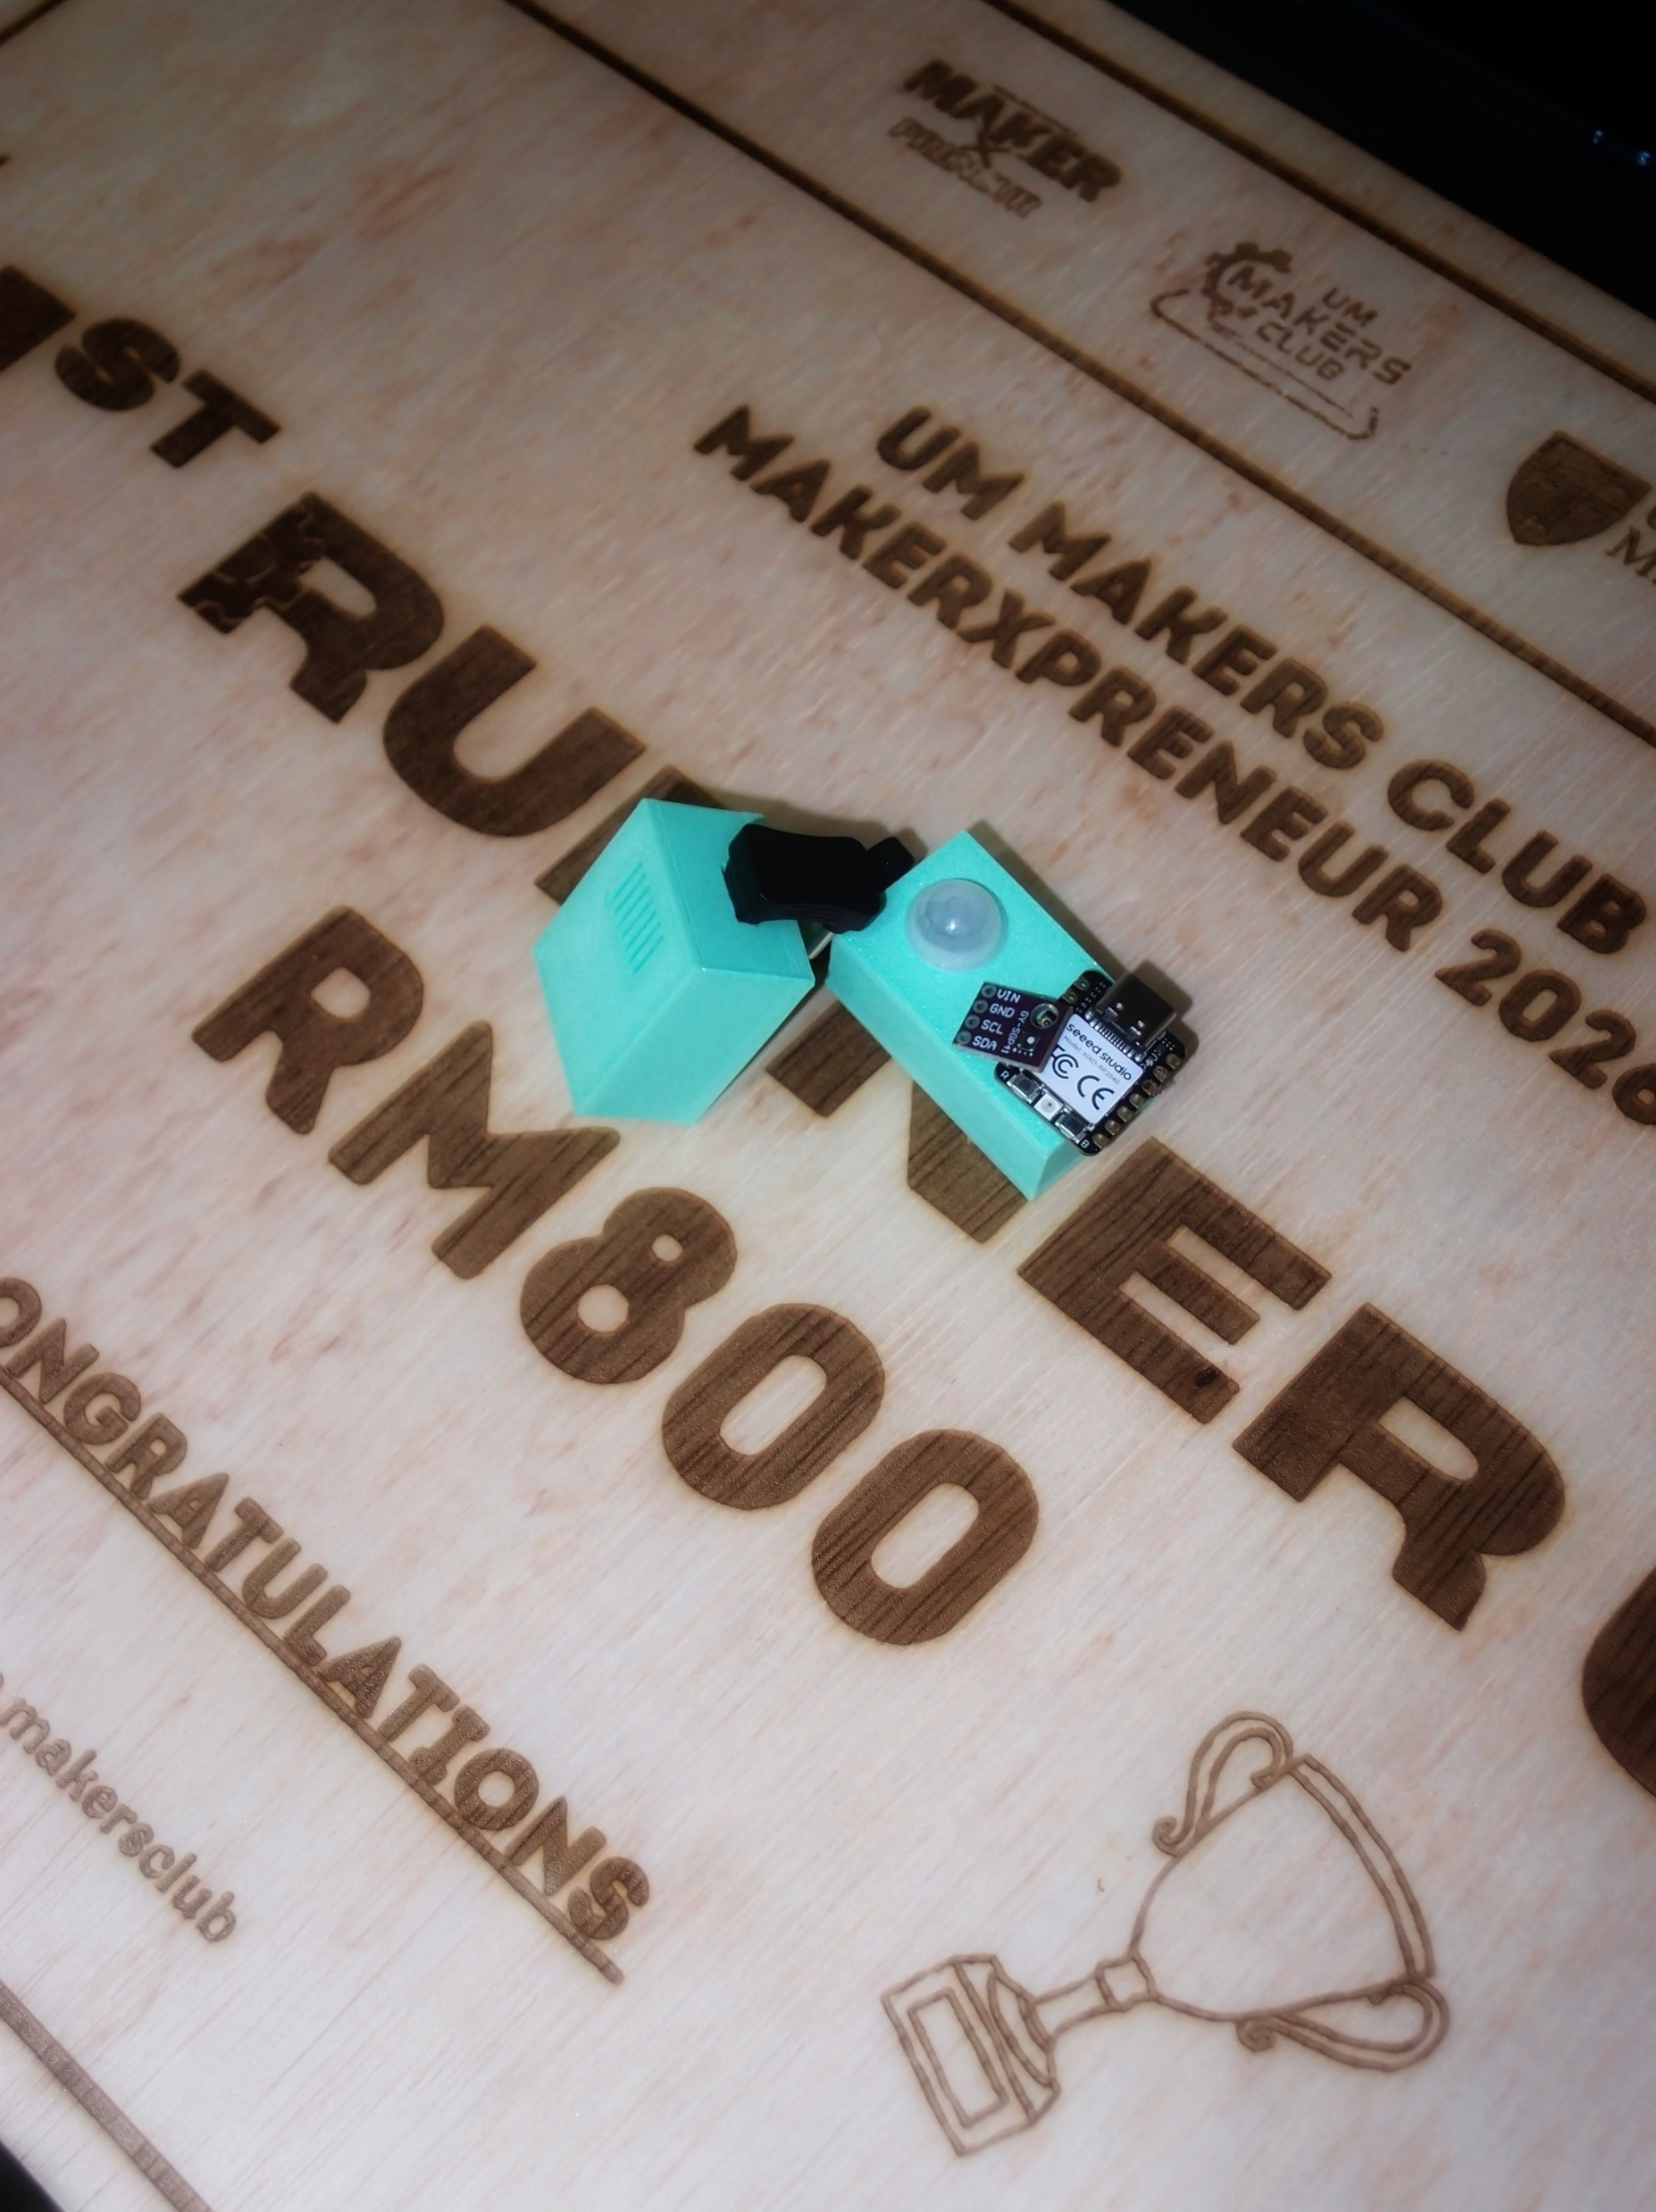
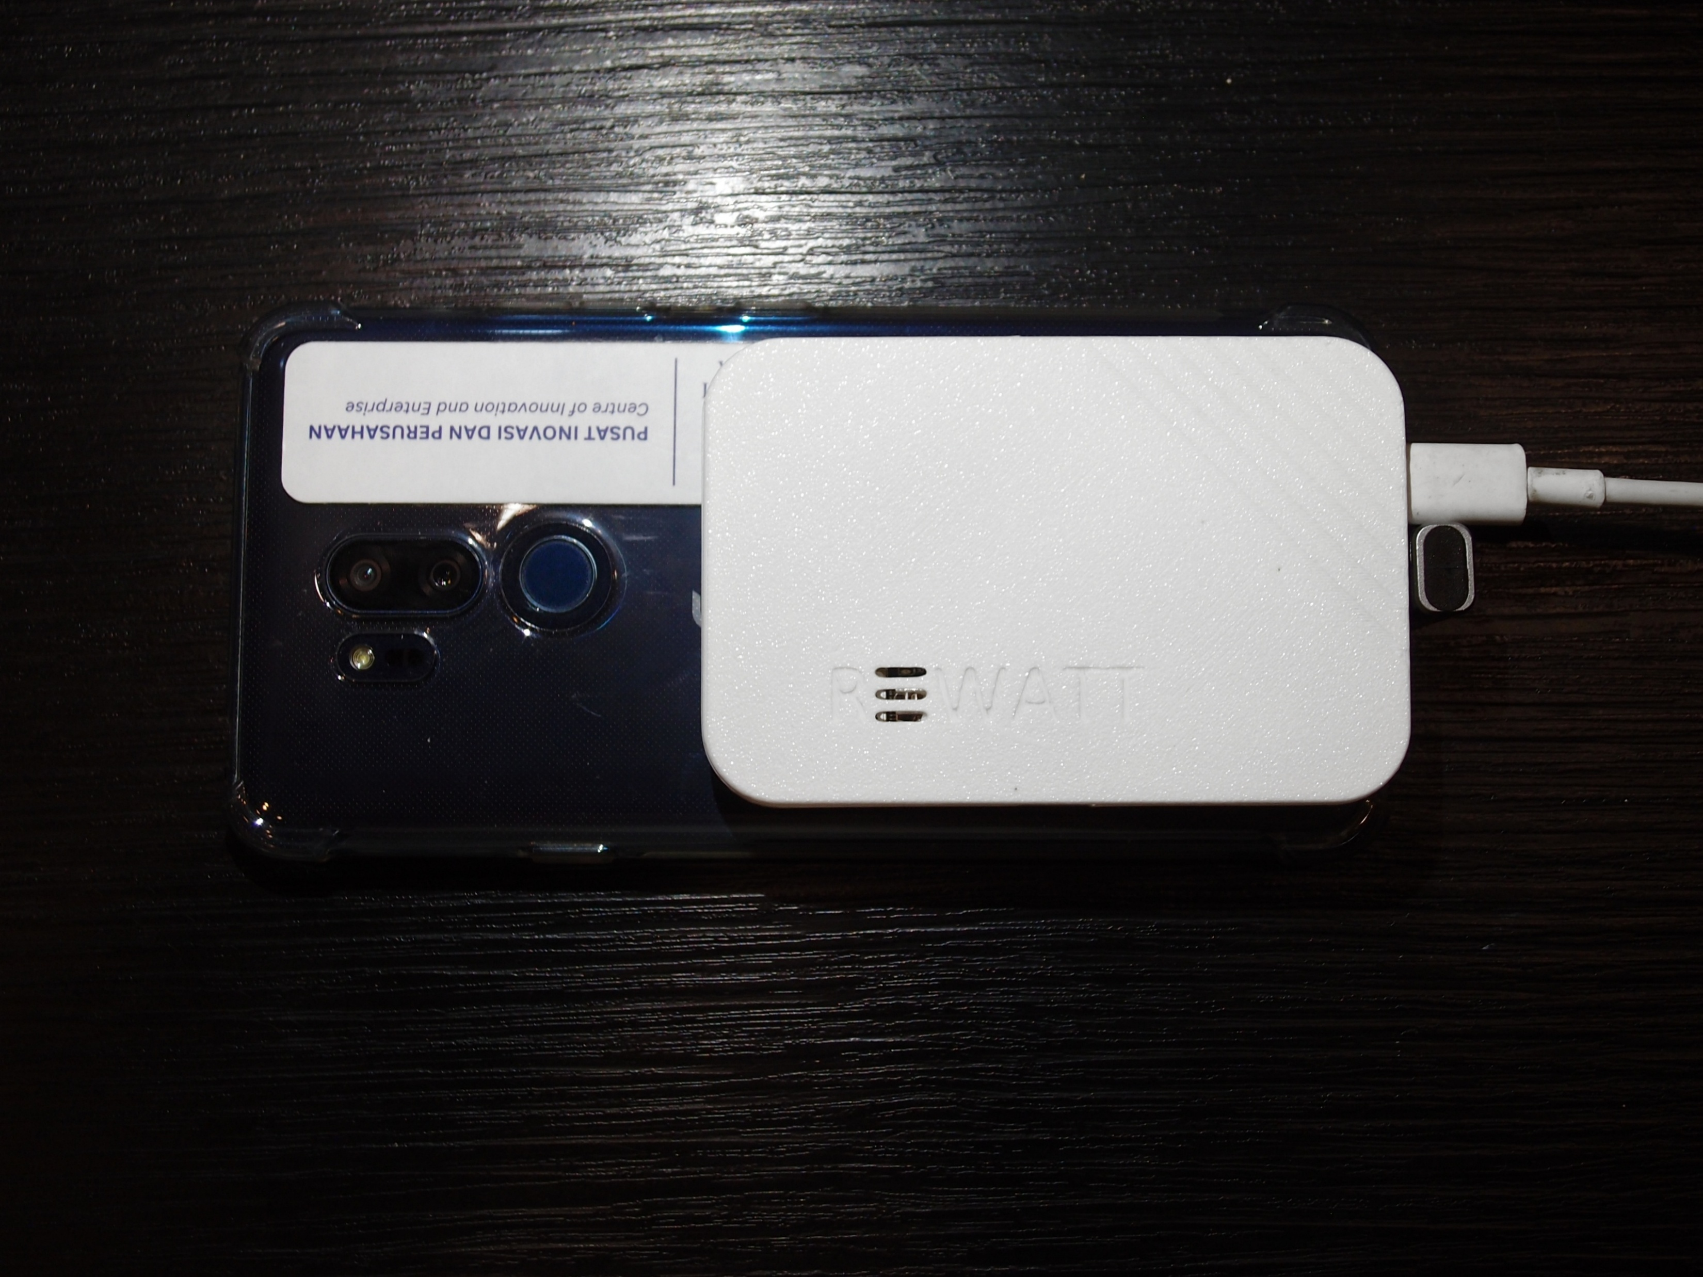
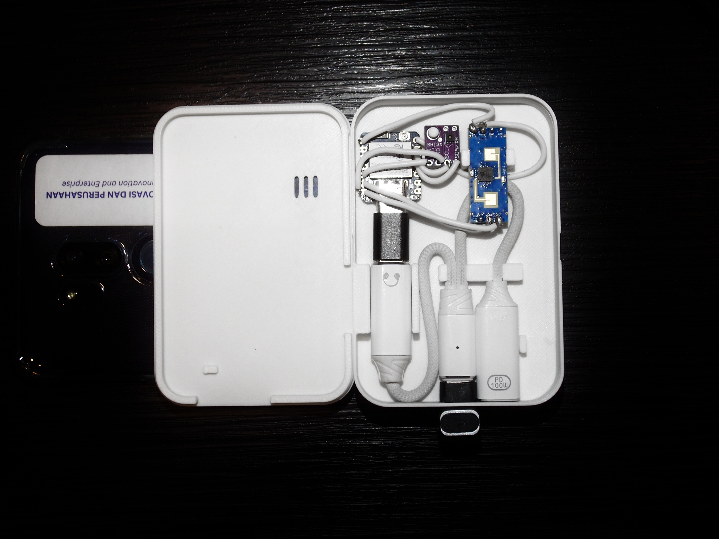
HACKATHON
05
BUILD SOMETHING REAL
让 IDEA 动起来。
Notes:
[Sources]
User-provided briefing.

